Slide 1
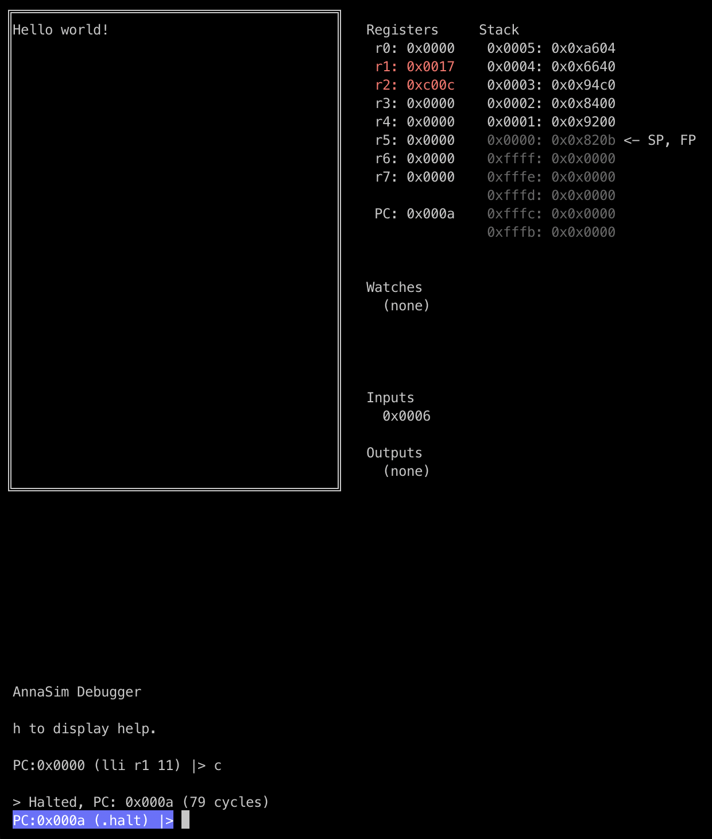
Registers
Stack (r7)
Simulated screen (0xC000)
Defined watches
Queued inputs
Outputs
Command prompt

